Slide 1
Infrastruktur Pendukung Smart City Surabaya, 13 Juni 2023
husin.tau@panduit.com
Channel Account Manager

Slide 2
Dunia yang semakin terkoneksi
Internet of Things (IoT)
Jumlah pengguna internet di Indonesia 215 juta jiwa (78.19% dari populasi penduduk)
Perangkat bisnis penghubung :
Akses poin (Wifi), perangkat keamanan (CCTV), Lampu LED PoE, Tata Udara (HVAC), lainnya.
Sumber : APJII
Notes:
We have all heard about the Internet of Things (IoT) but we may not always think about how big of an influence it has on the business network. According to Gartner, globally, in 2017 there were 8.4 Billion IoT devices. This number will continue to grow and by 2020, it is expected that 20.4 billion devices will be connected.
A subset of all devices are the IoT devices used in a business building. Sometime, this will be called the Building Internet of Things or BIoT. We are considering all the devices that will be connected to the network and will include, PoE LED lighting, building systems such as HVAC, video cameras, key pads, sensors and more.
Gartner estimates there were 1.5 billion business devices in 2017 and expects 4.38 billion by 2020. All of these devices are connected to a network. It is important that the structured cabling products that supports the network is of the highest quality.
Worldwide Gartner numbers

Slide 3
Ruang Kerja Modern (Modern Workplace)
Koneksi internet yang cepat dan terhubung di setiap ruang kerja
Ruang kerja dan ruang meeting yang fleksibel dapat meningkatkan produktivitas
Lebih menarik minat bagi kaum milenials karena menjadi lebih mudah untuk beradaptasi
Setiap ruang dapat dioptimalkan sehingga terjadi efisiensi dari sisi penggunaan energi / listrik.
Notes:
BUSINESS DRIVERS
In addition to looking at the JLL rule of Thumb, we are seeing the trends of a changing workplace and the workforce. As we have shown, Millennials are the largest growing segment of the workforce and companies are moving to the cities where the younger workforce reside. To be competitive, companies must fight for the best talent.
Improve employee Productivity
A business is only as good as its people. Making your people more productive, benefits your business. Providing a compelling work environment, that can adapt to the individual or be personalized by the individual will improve overall productivity. Employees want to have the ability to adjust lighting, temperature, to meet their personal needs…from their cell phone.
Optimize real-estate
In the cities, space is at a premium and is expensive. Companies are being forced to understand how their workspace is being used so they can optimize every square foot. Current trends show a transformation in the work environment. Wide open, one-size-fits-all, wall-to-wall cubicle spaces are being replaced by an environment that is smaller, flexible, intimate, and fun. Employers are wooing a younger, more collaborative workforce that cares about things like the health and wellness of the work space and flexible working conditions.
Lower energy costs
Next to the costs of people and real estate, energy is the next big expense. Businesses are looking for ways they can lower their lighting, heating, and cooling costs. Installing sensors in rooms and corridors with smart software can help lower energy bills. The variety of sensors have increased dramatically in the last few years and at the same time, their price has dropped substantially. We can now have sensors that are smart enough to adjust the temperature and lighting as well as to collect metrics on office space utilization.
Connected devices such as sensors provide the intelligence that allows flexible, healthy, efficient spaces to be created. Business demands are driving companies to look for new ways to use the IoT and the network to improve their business.

Slide 4
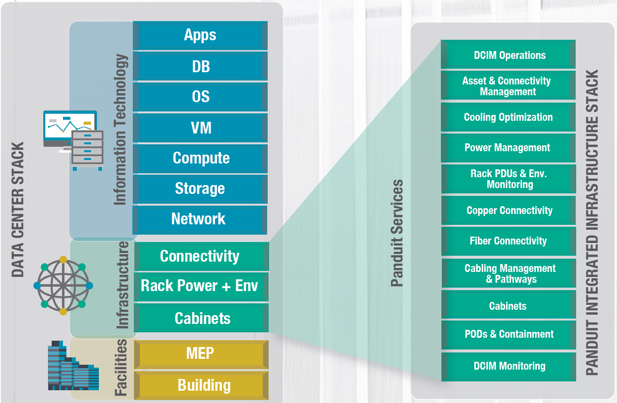
Bagaimana semua ini terkoneksi
Notes:
Putting all of these trends together they show the IoT future. Here we are showing a representation of the various layers of the technology trends for the modern building. It starts at the edge with the PoE LED Lighting, smart devices including sensors, data and the analytics that can be done with the data. It is completely supported by an all IP network that runs over structured cabling. The infrastructure platform of a an all IP network with PoE IoT devices is called the, "Digital Ceiling”.
The network is managed, controlled, and powered by a PoE IP switch and the management software. Finally there are the applications that run on the network or remote devices.
As an example, if you have your PoE LED lighting management software on the network, you can remotely manage it using a mobile device that is connected wirelessly to the network.

Slide 5
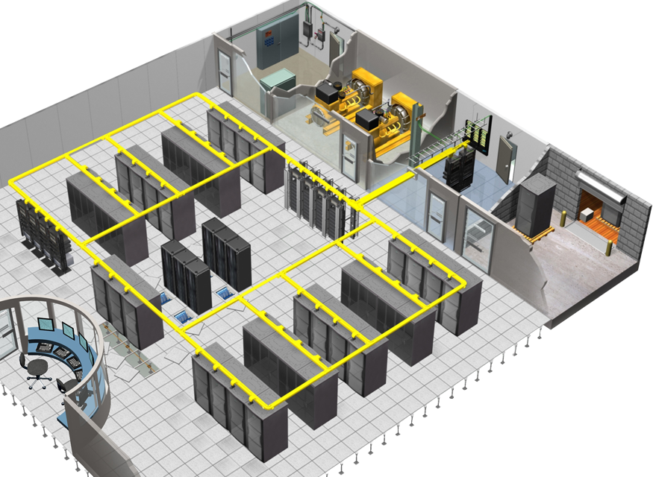
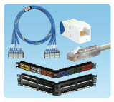
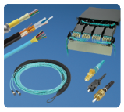
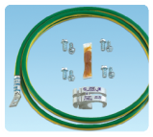
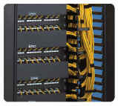
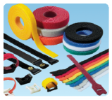
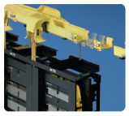
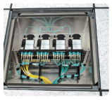
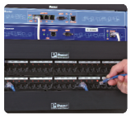
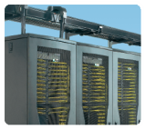
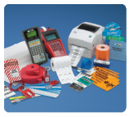
Solusi Terpadu PANDUIT
Copper Cabling Systems (Quicknet)
Fiber Cabling Systems (Quicknet)
Grounding & Bonding Systems
Cable Management
Lock in & Block Out
Fiber & Copper
Routing Systems
Zone Cabling Systems (ODR)
Managed Network
Systems (REK,SMARTZONE)
Cabinets & Rack Systems
Identification Solutions (Labeling)

Slide 6
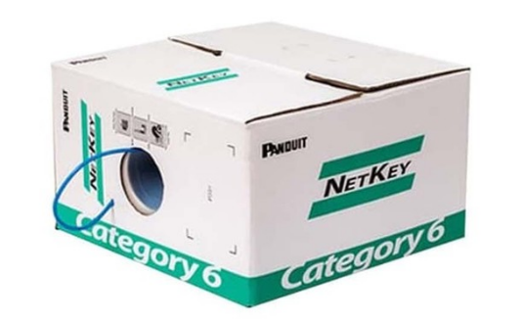
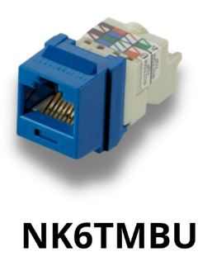
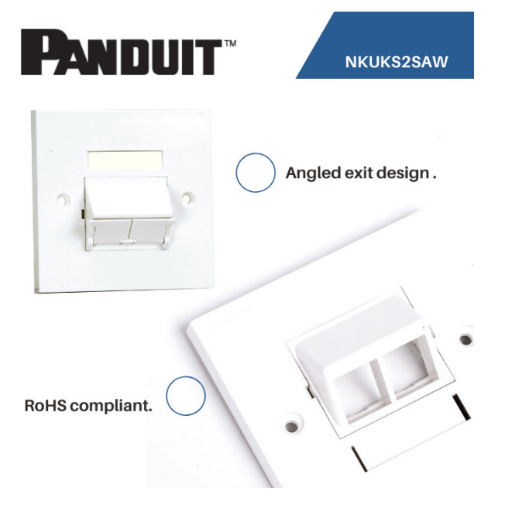
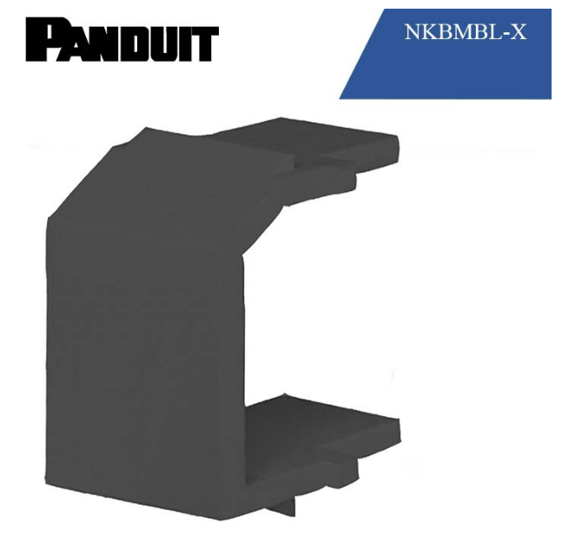
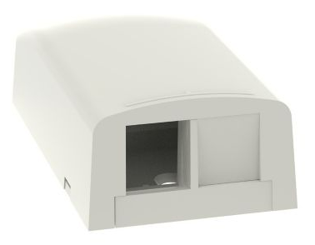
Perangkat jaringan kabel UTP dan aksesorisnya
NKFPL24 / NKFPL48
Kabel data :
Cat6 (NUC6C04BU-FE)
Cat6A (NUL6X04BU-VEG)
Surface Mount Box
(NK2BXIW-A)

Slide 7
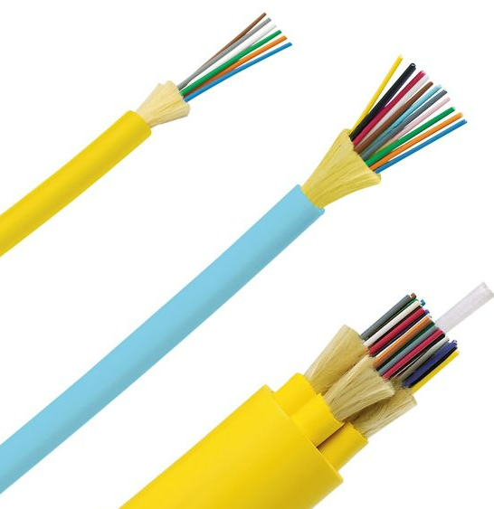
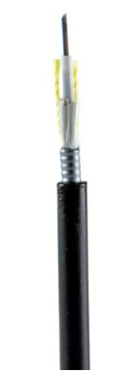
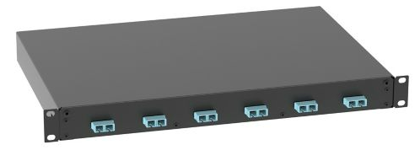
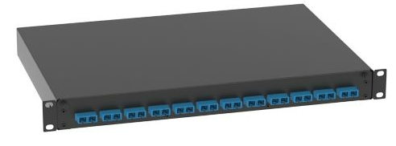
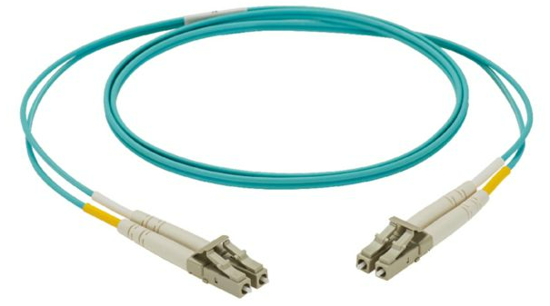
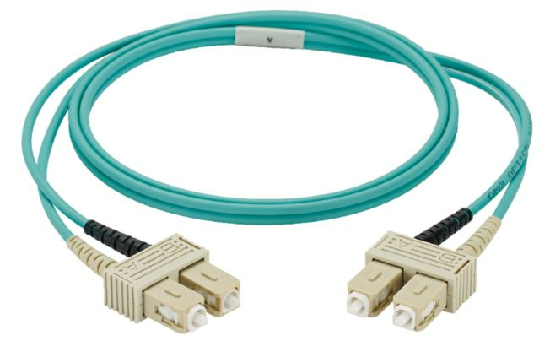
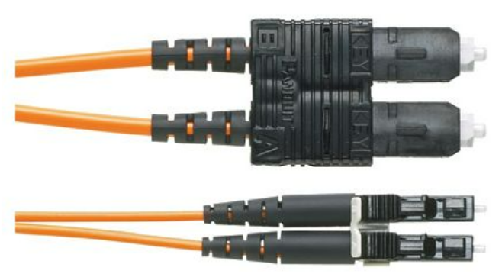
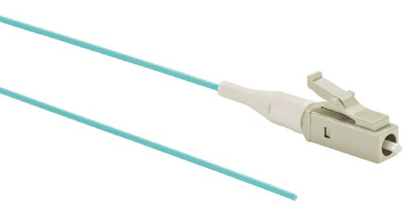
Perangkat jaringan kabel Fiber (FO) dan aksesorisnya
FLDL : Indoor Distribution LSZH
FLDR : Indoor Distribution Riser
OS2, OM3 & OM4
6 /12 / 24 Fiber
FLKL : Indoor/Outdoor Distribution LSZH
OS2, OM3 & OM4
6 /12 / 24 Fiber
FLSN : Outside Plant Armored
OS2, OM3 & OM4
6 /12 / 24 Fiber
Fiber Drawer :
OS1/OS2, OM3 & OM4
6 / 12 / 24 Duplex SC/LC adapters
Fiber Patchcord :
OS2,OM3 & OM4
LC Duplex LC Duplex, LC Duplex SC Duplex, SC Duplex SC Duplex
1m – 15m
Fiber Pigtail (1m) :
OS2, OM3 & OM4
LC to Pigtail & SC to Pigtail

Slide 8
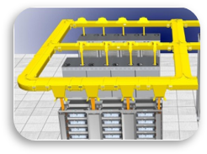
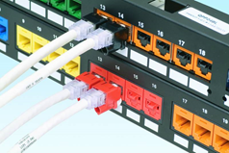
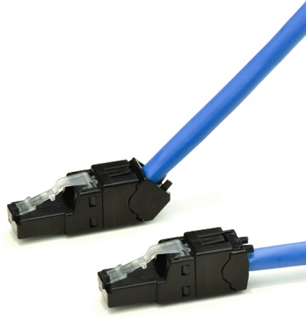
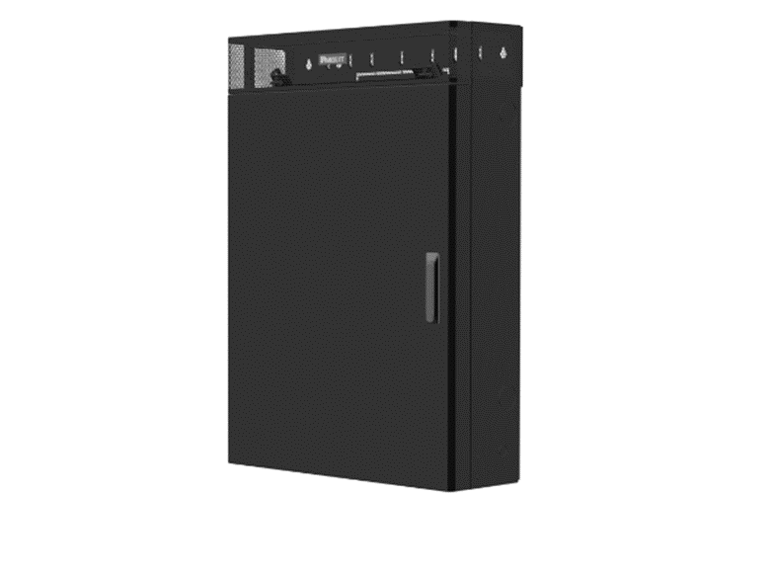
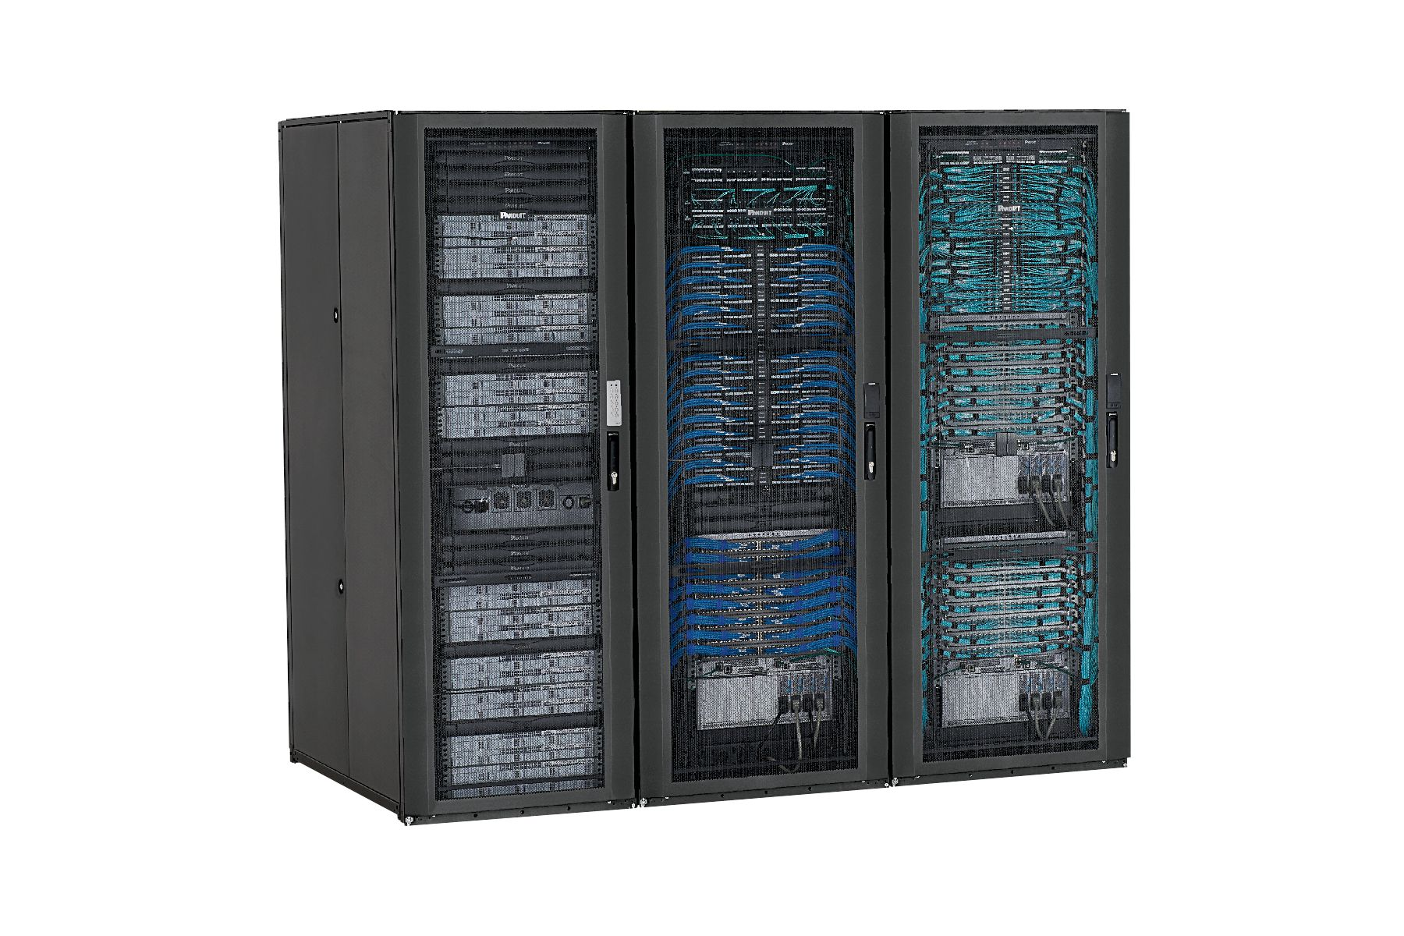
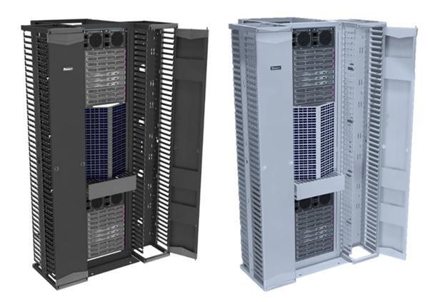
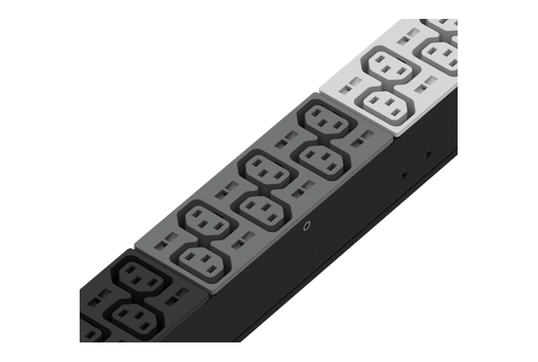
Solusi di dalam Data Center
Wyr-Grid Basket Tray
FiberRunner Tray
Security Devices
WiFi Connectivity
Wall Mount Enclosure
Network and Server Cabinets
Open Rack Systems
Power Distribution
Notes:
Message: End-to-End solution

Slide 9
Layanan purna jual
Garansi :
1 tahun untuk garansi produk
15-25 tahun untuk system warranty
Meliputi biaya perbaikan dan juga komponen yang diganti
Memenuhi standar dari ANSI, TIA/EIA and ISO
Panduit 1 tahun garansi produk
Panduit 15 - 25 tahun garansi menyeluruh

Slide 10
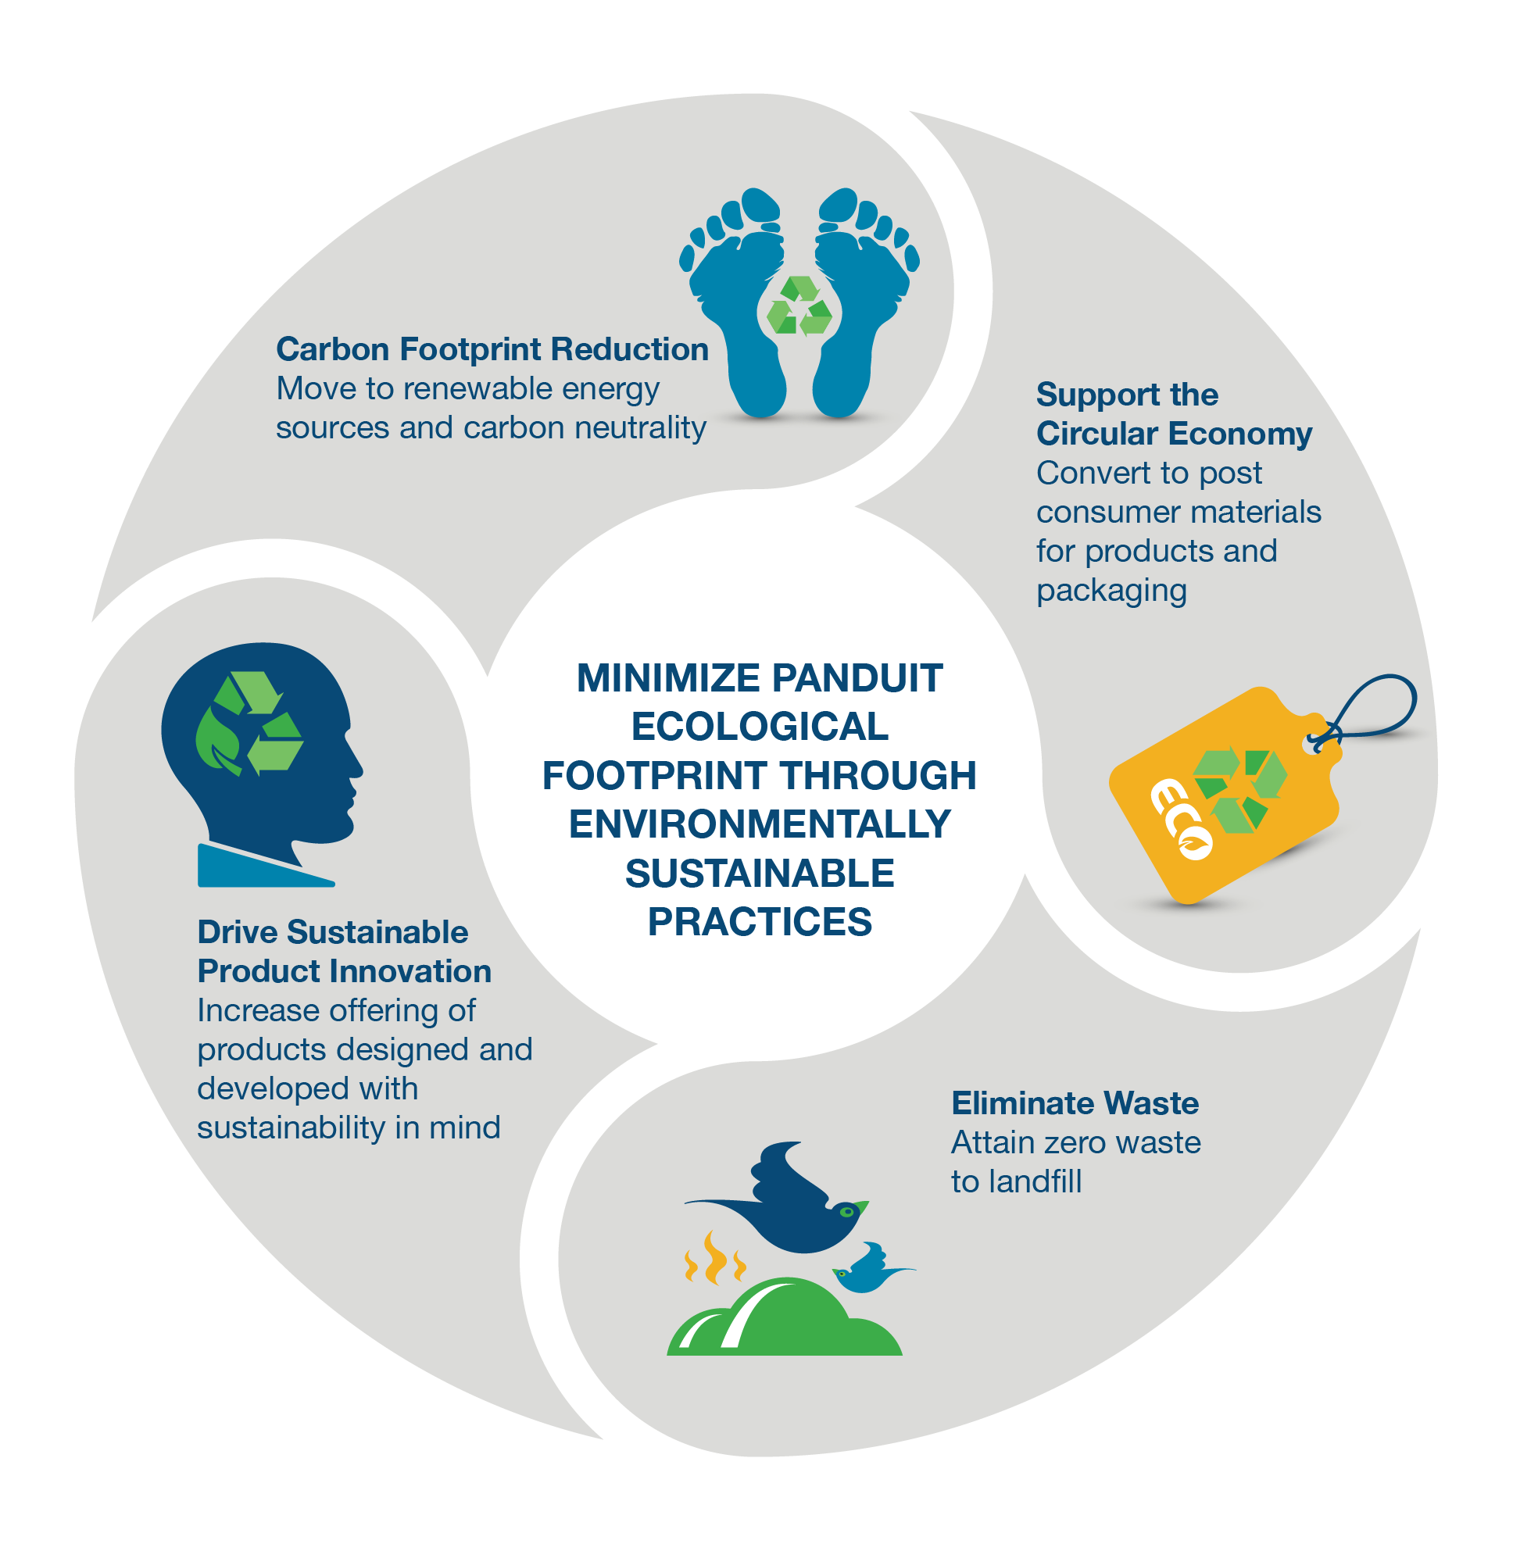
Panduit
Komitmen akan riset dan pengembangan yang berkelanjutan untuk menghasilkan solusi terbaik ke setiap pengguna
Mendukung pengurangan jejak karbon, ekonomi sirkular, inovasi desain dengan mengurangi sampah plastik pada kemasan.
Bekerjasama dengan sekolah / instansi Pendidikan untuk memberikan pengetahuan dan pelatihan mengenai teknologi jaringan infrastruktur untuk pembekalan pada saat memasuki dunia kerja.
www.panduit.com

Slide 11
Terima kasih!

