Slide 1


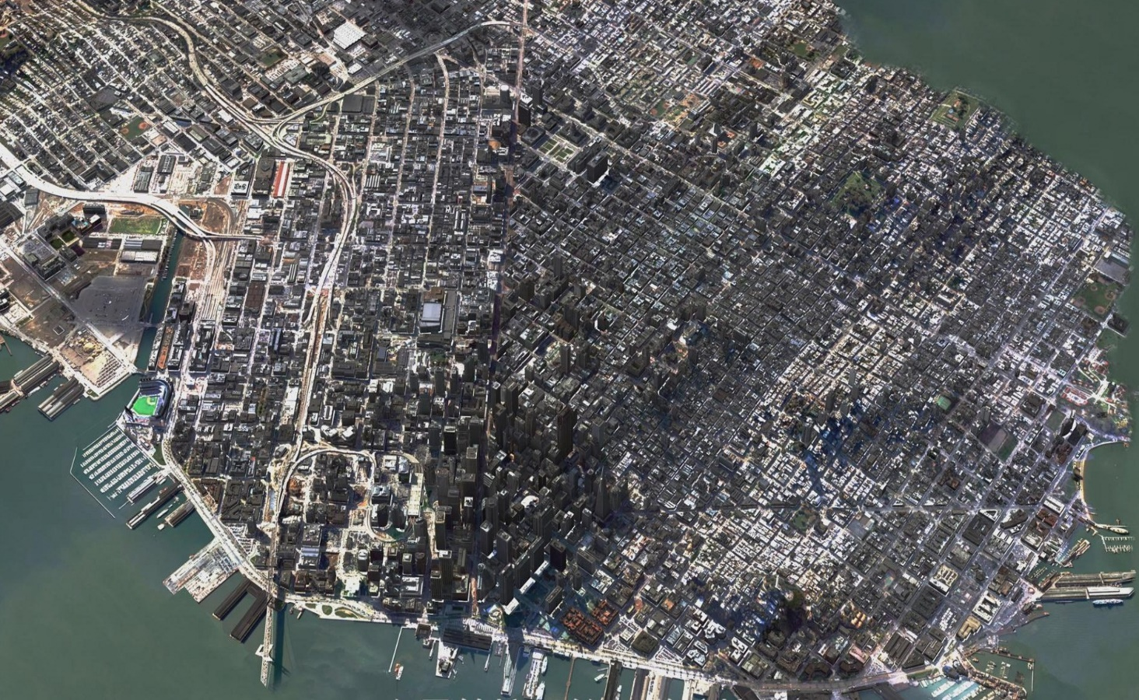


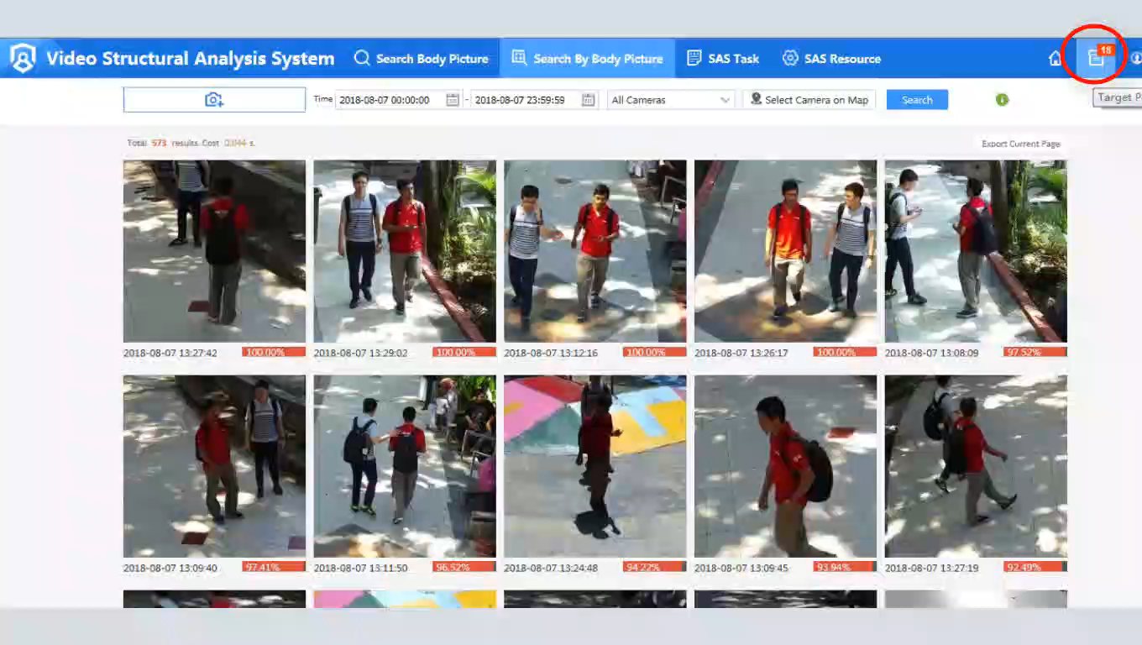
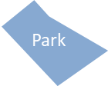



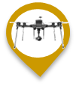



Keamanan Publik–Desain Tata Letak Pengawasan Kota
Pintu Masuk Kota
Jalan Utama Kota
Government agency
Kawasan Utama
Daerah Buta
Menyeluruh dengan cakupan luas

Slide 2







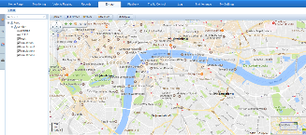
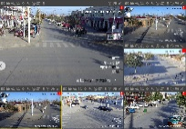






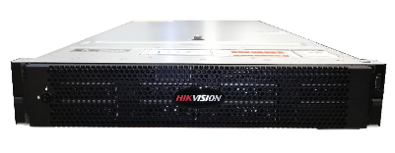



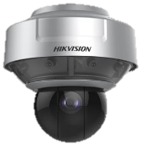
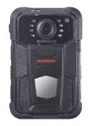
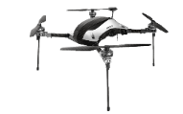




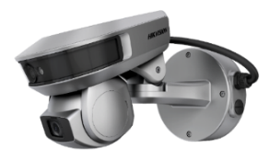
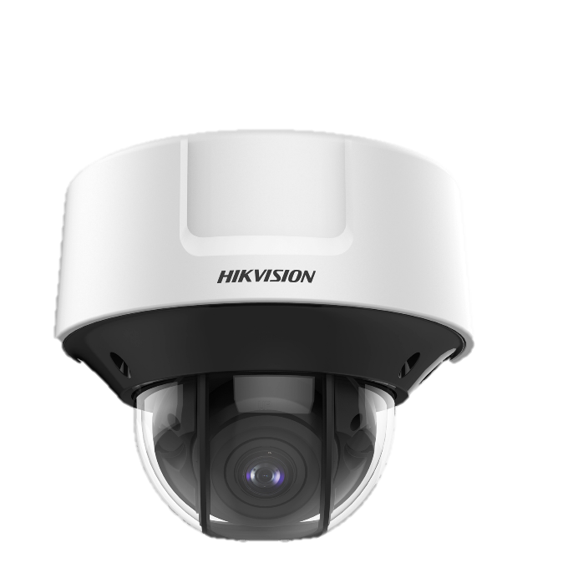
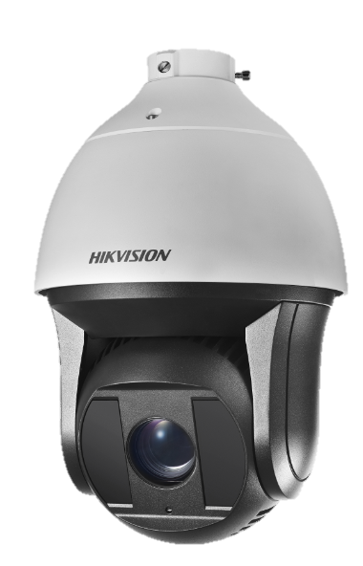
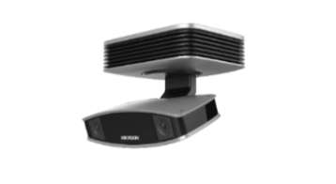
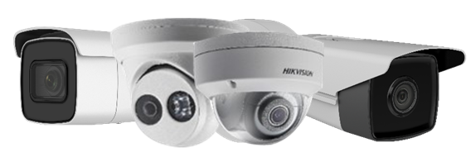
3 Fase Pengembangan Smart City-3C
P3: Penggabungan dan Berbagi Data
COMPREHEND
P2: Sistem Video Cerdas
COLLECT
Pemerintah Pusat
P1: Pengawasan Dasar
Pengenalan Objek
Deteksi Insiden
Berbagi Data
CONNECT
Pelacakan target
Alarm Blacklist
Alarm khushs
Kota M
……
Kota A
……
Kota N
CCTV
GIS
Kontrol target
Penegakan Pelanggaran
……
Alarm
Perintah dan Penugasan
Business experience
Wajah
Badan
kendaraan
Alarm
Data Fusion
Data Terstruktur
Aplikasi Keamanan Dasar
Video
Modeling
Dat Terstruktur
Data Video
Data Bisnis
Pusat kendali
Deep-learning analysis Servers
Video Network
Government Affairs Network
Video Collection
Pengembangan
Yang saling melengkapi
Komprehensif
Terintegrasi
Inovatif
Koleksi video
Fungsi Bisnis Baru
Perangkat AI
Perangkat Konvensional
Notes:
三个阶段-Connect –Collect-Comprehend:
第一阶段，基于CCTV系统的城市监控覆盖各个业务部门，实现事件的实时监控和预警，
第二阶段，通过IOT智能设备的能力注入，对现实世界进行结构化数据的（IOT数据如人、车、人体、环境数据）等进行提取和展现（如果是和SI交流，则需要重点强调，IOT数据可以加强和用户的黏性，摆脱传统的CCTV价格战的红海竞争，与用户强绑定进行深耕，同时也需要明确智能的注入，让项目从第一阶段的传统CCTV变成了第二阶段的IT系统设计，SI需要投入更多的资源去支撑和设计、落地）
第三阶段：基于IOT数据（现实世界的结构化数据）的基础上，结合用户的业务数据及用户的业务逻辑及经验（如用户的OA数据，用户的刑侦破案经验），在系统上进行用户的业务实现
Three stages - Connect - Collect - Comprehend:
In the first stage, urban monitoring based on CCTV system covers all business departments to realize real-time monitoring and early warning of events.
The second stage, through the IOT intelligent equipment capacity injection, in the real world for structured data (IOT data such as people, cars, the human body, environment) and so on carries on the extraction and display (if IT is to communicate with SI need to highlight, IOT data can strengthen and user viscosity, breaking away from the traditional CCTV competition on price of the red sea, deep tillage with user strong binding, also need to clear the intelligent injection, let the project from the first stage of the traditional CCTV turned into the second phase of the IT system design, SI need to invest more resources to support and design, the ground)
The third stage: based on IoT data (structured data in the real world), combined with users' business data and business logic and experience (such as users' OA data and experience in criminal investigation and solving cases), the user's business implementation is carried out on the system

