Slide 1
Smart City Solution
From
PT Virtus Technology Indonesia
Fatih Sugiharno
Technical Consultant

Slide 2
Smart City
The meaning of smart city implies the integration of current substructure with new information and communication technologies to create a comprehensive system of efficient urban services (Maruf et al., 2020).

Slide 3
Smart City Challenges
High Technology
Data personal
Financial
Regulation

Slide 4
Smart city & Cybersecurity
The data being collected, transmitted, stored, and processed, which can include significant amounts of sensitive information from governments, businesses, and private citizens.
The complex artificial intelligence-powered software systems, which may have vulnerabilities, that smart cities sometimes use to integrate this data.

Slide 5
New technology, new opportunity cyber attackers
Traffic control systems and traffic lights in intelligent traffic control systems
Forgery of data from various sensors (Earthquakes, floods, etc)
Privacy breaches on smart building

Slide 6
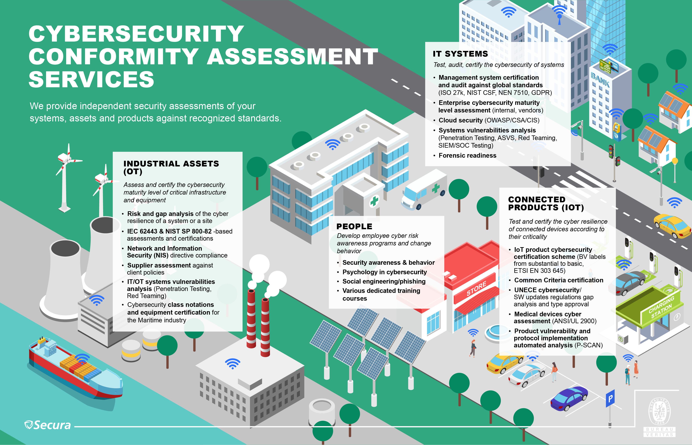
Smart city Path

Slide 7
Distribution of product security evaluation, compliance and certification.
Support and Preparation | - Design Reviews - Security Requirements Development - Threat Modeling - Vulnerability Assessments and Penetration Testing of Hardware, Software and Infrastructure
Compliance and Testing | - ETSI EN 303 645 - P-SCAN (product vulnerability scanning)
Certification | - OWASP - IoXT - CTIA - ETSI EN 303 645 - Common Criteria Certification - Radio Equipment Directive (RED) - EUROSMART IoT Certification

Slide 8
Physical Security
Data Backup and Recover
Data Loss Prevention

Slide 9
Network Security
Firewall
Monitoring Tools
Network Detection and Response
Encryption, Forensic and Analysis
WAN Optimization
Secure Code Analyzer

Slide 10
End-User Security

Slide 11
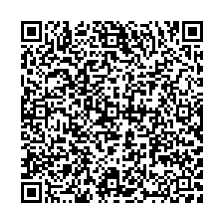
Thank You

